Slide 1
Introduction to Scrum
Scrum is an agile framework for managing projects and product development. It emphasizes collaboration, adaptability, and delivering value to customers.
Scrum, the agile powerhouse, challenges the old-fashioned, siloed approaches with a relentless spirit of adaptability and collaboration, turning every obstacle into a stepping stone to innovation and excellence.

Slide 2
Scrum Principles
Scrum principles include:
Transparency: in Scrum ensures that all aspects of work are visible, promoting trust and informed decision-making.
Inspection : involves regular examination of the product and processes, enabling early issue detection and continuous improvement.
Adaptation: allows Scrum teams to make flexible changes based on inspection results, responding to evolving needs.
Self-organizing teams: empower individuals to take ownership of their work, fostering motivation and creativity.
Collaboration: is at the heart of Scrum, promoting open communication and shared responsibility among team members and stakeholders.
Time-boxed sprints: provide focused periods for work completion, fostering predictability and enabling iterative delivery.

Slide 3
Scrum Process & Roles
The Scrum process includes the Product Backlog (list of work), Sprint (timeboxed development cycle), and Increment (potentially shippable product increment).
Scrum roles consist of the Product Owner (maximizing value), Scrum Master (servant-leader), and Development Team (self-organizing, cross-functional).

Slide 4
Product Roles
The Product Owner is responsible for defining and prioritizing items in the Product Backlog, ensuring the team delivers the most value.
The Scrum Master supports the team in adhering to Scrum principles, removing obstacles, and facilitating ceremonies.
The Development Team is a self-organizing group responsible for delivering a potentially shippable product increment.

Slide 5
Sprint (Planning, Review, Retrospective)
Sprint Planning involves selecting items from the Product Backlog and creating a Sprint Backlog, defining what can be delivered during the Sprint.
The Sprint Review is a meeting at the end of the Sprint to review the Increment with stakeholders and adapt the Product Backlog.
The Sprint Retrospective is a meeting after the Sprint Review to reflect on the Sprint and identify areas for improvement.

Slide 6
Scrum Artifacts
Scrum artifacts include Product Backlog, Sprint Backlog, and Increment.
The Product Backlog is a prioritized list of work items, often represented as user stories or features.
The Sprint Backlog is a subset of the Product Backlog items chosen for the current Sprint.
The Increment is the sum of all completed Sprint Backlog items. It should be potentially shippable.

Slide 7
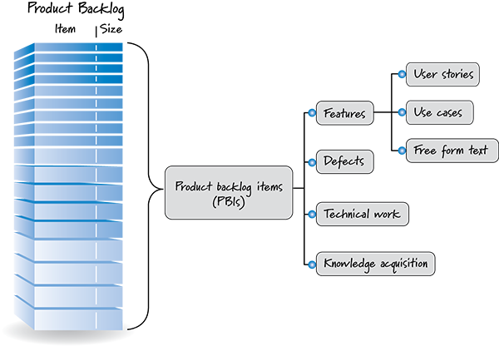
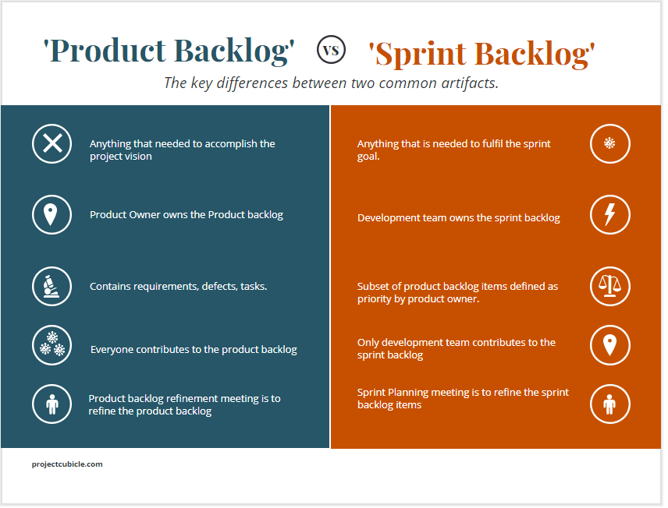

Slide 8
Scrum Events and Planning
Scrum events include Sprint Planning, Daily Scrum, Sprint Review, and Sprint Retrospective.
Sprint Planning involves selecting items from the Product Backlog and creating a Sprint Backlog, defining what can be delivered during the Sprint.

Slide 9
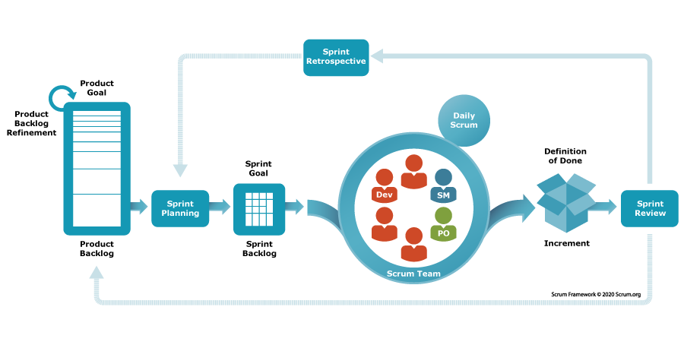

Slide 10
Introduction to DevOps
DevOps is a set of practices that aims to automate and integrate the processes between software development and IT operations.
DevOps principles include collaboration, automation, measurement, and sharing (CAMS).
DevOps promotes a culture of collaboration, shared responsibility, and continuous improvement.

Slide 11
DevOps Process and Tools
The DevOps process involves planning, coding, building, testing, releasing, deploying, operating, and monitoring.
DevOps utilizes various tools such as Jenkins, Docker, Ansible, and Kubernetes for automation and orchestration.

Slide 12
Continuous Integration (CI) and Delivery (CD)
CI is the practice of frequently merging code changes into a shared repository and running automated tests.
CD extends CI by automatically deploying code changes to production or staging environments.

Slide 13
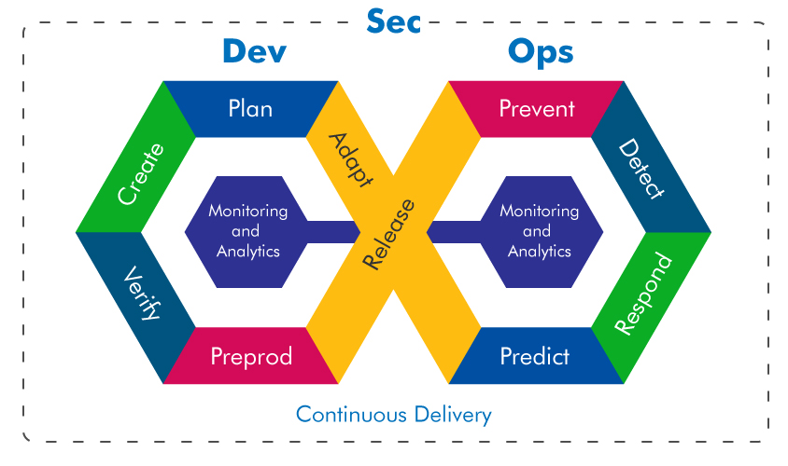

Slide 14
Infrastructure as Code (IaC)
IaC is the practice of managing and provisioning infrastructure through code and automation. IaC in DevOps involves automating infrastructure provisioning and management using code.
Steps to implement IaC include selecting a tool, defining infrastructure, version control, automation, testing, deployment, monitoring, and continuous updates.
Benefits of IaC include automation, version control, scalability, cost efficiency, faster deployment, reduced risk, consistency, collaboration, flexibility, and enhanced security.

Slide 15
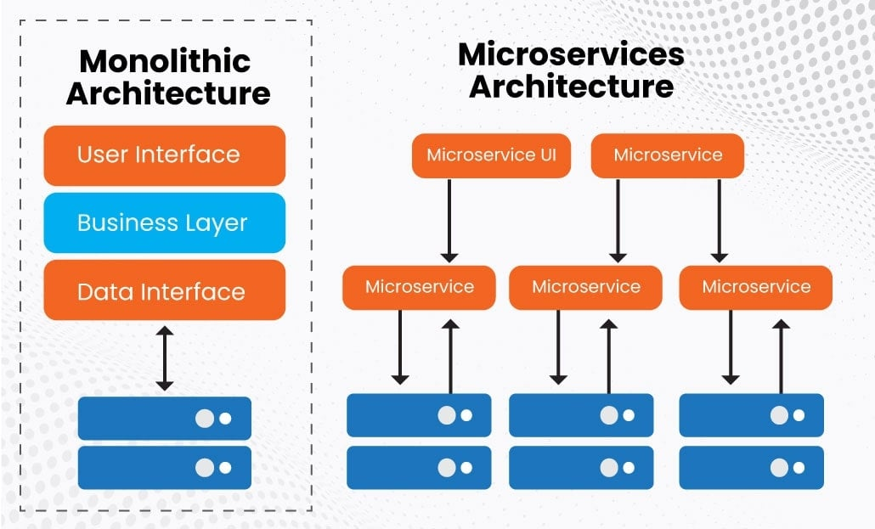
Microservices Architecture
Microservices is an architectural style that structures an application as a collection of small, independent services.

Slide 16
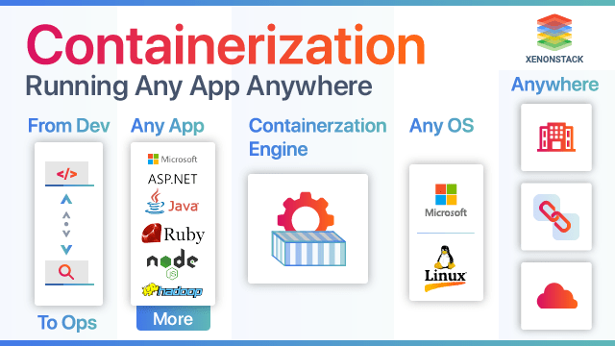
Containerization
Containerization, using tools like Docker, allows applications to run consistently across environments.

Slide 17
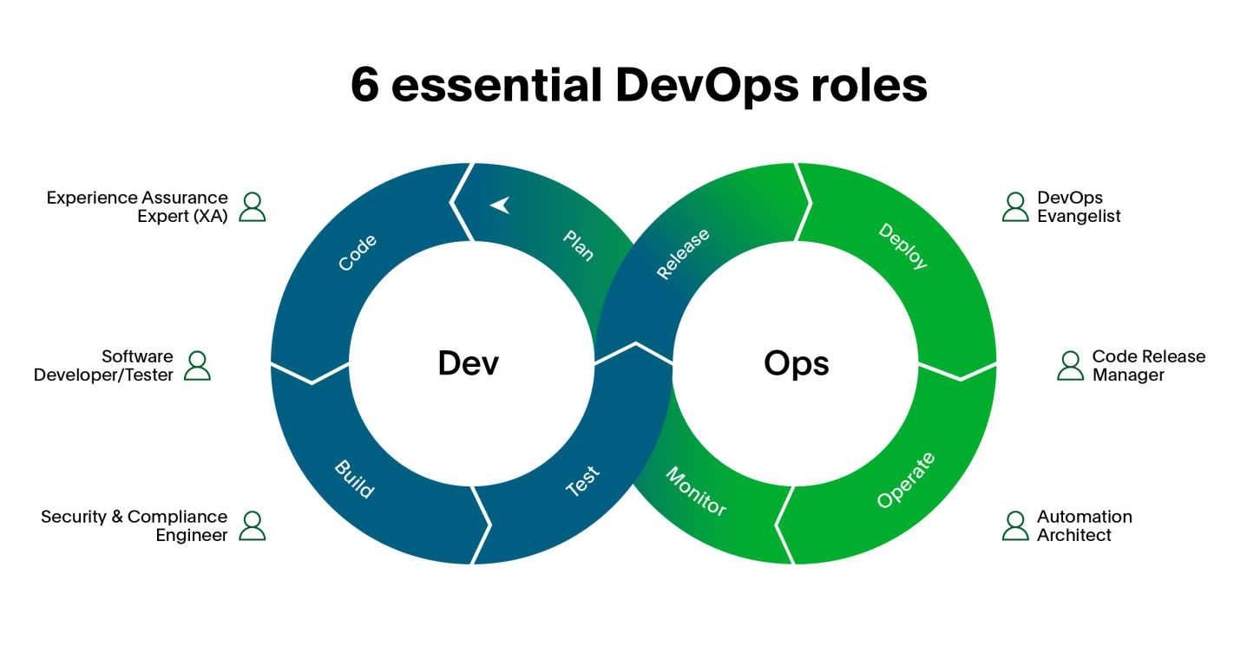
People Involved
DevOps involves cross-functional teams, including developers, testers, operations, and business stakeholders.

Slide 18
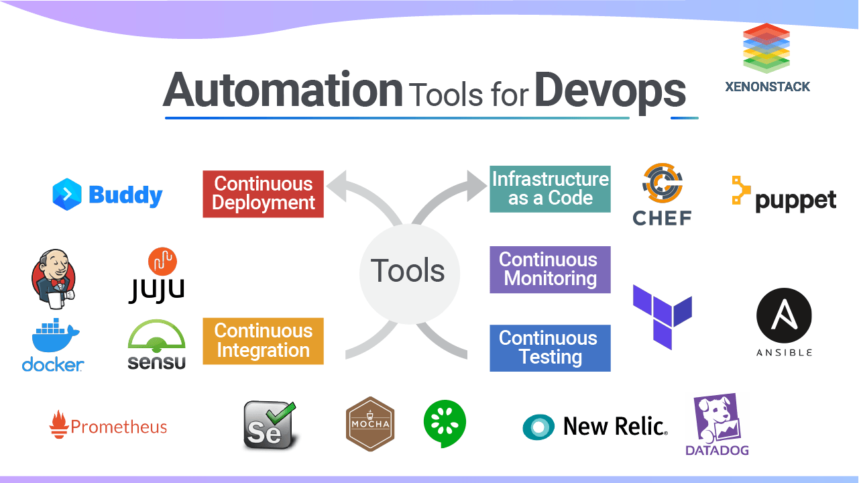
Examples of DevOps Tools
Examples of DevOps tools include Jenkins for CI/CD, Ansible for automation, and Docker for containerization.

Slide 19
Benefits and challenges of DevOps
DevOps leads to faster software delivery, improved collaboration, reduced errors, and increased efficiency.
Challenges in DevOps include resistance to change, tool complexity, and security concerns.

Slide 20
DevOps in Practice and Future
DevOps adoption can vary, but it often involves creating a DevOps culture and implementing automation.
The future of DevOps involves further automation, AI and machine learning integration, and improved security practices.

Slide 21
Comparison of Agile Frameworks
Aspect | Scrum | XP | DevOps | Kanban
Principles | Transparency, Inspection, Adaptation | - Simplicity, Communication, Feedback, Courage | - Collaboration, Automation, Measurement, Sharing (CAMS) | - Visualizing work, Limiting work in progress, Managing flow
Roles | - Scrum Master, Product Owner, Development Team | - Programmer, Customer, Tracker, Coach, Manager | - DevOps Engineer, Developer, Operations, Tester, Product Owner | - No prescribed roles, team-based approach
Methods | - Iterative development, Sprints, Product Backlog | - Pair programming, Test-driven development, Continuous Integration | - Automation, Continuous delivery, Infrastructure as Code | - Visual boards, Flow metrics
Tools | - Scrum boards, Jira | - Version control, Testing frameworks, Jenkins | - CI/CD tools (e.g., Jenkins), Infrastructure provisioning tools (e.g., Terraform) | - Kanban boards, Digital task boards
Common Features | - Iterative development, collaboration | - Iterative development, collaboration, TDD | - Iterative development, automation, collaboration | - Visualizing work, limiting WIP, managing flow
Key Ceremonies | - Sprint Planning, Daily Scrum, Sprint Review, Sprint Retrospective | - Standup meetings, Planning game, Refactoring | - Continuous Integration, Continuous Deployment, Release management | - No prescribed ceremonies, continuous flow
Focus | - Project management | - Software development practices | - Software delivery and infrastructure automation | - Workflow optimization and continuous improvement
Artifacts | - Product Backlog, Sprint Backlog, Increment | - User stories, Acceptance tests, Continuous Integration server | - Infrastructure as Code scripts, CI/CD pipelines | - Kanban boards, Cumulative flow diagrams

Slide 22
AI-Augmented Software Development:
In recent years, AI has become increasingly intertwined with software development. Software development has taken on a more intelligent form, with AI being used to automate the entire software development lifecycle, from writing code and testing it to deploying and monitoring applications.

Slide 23
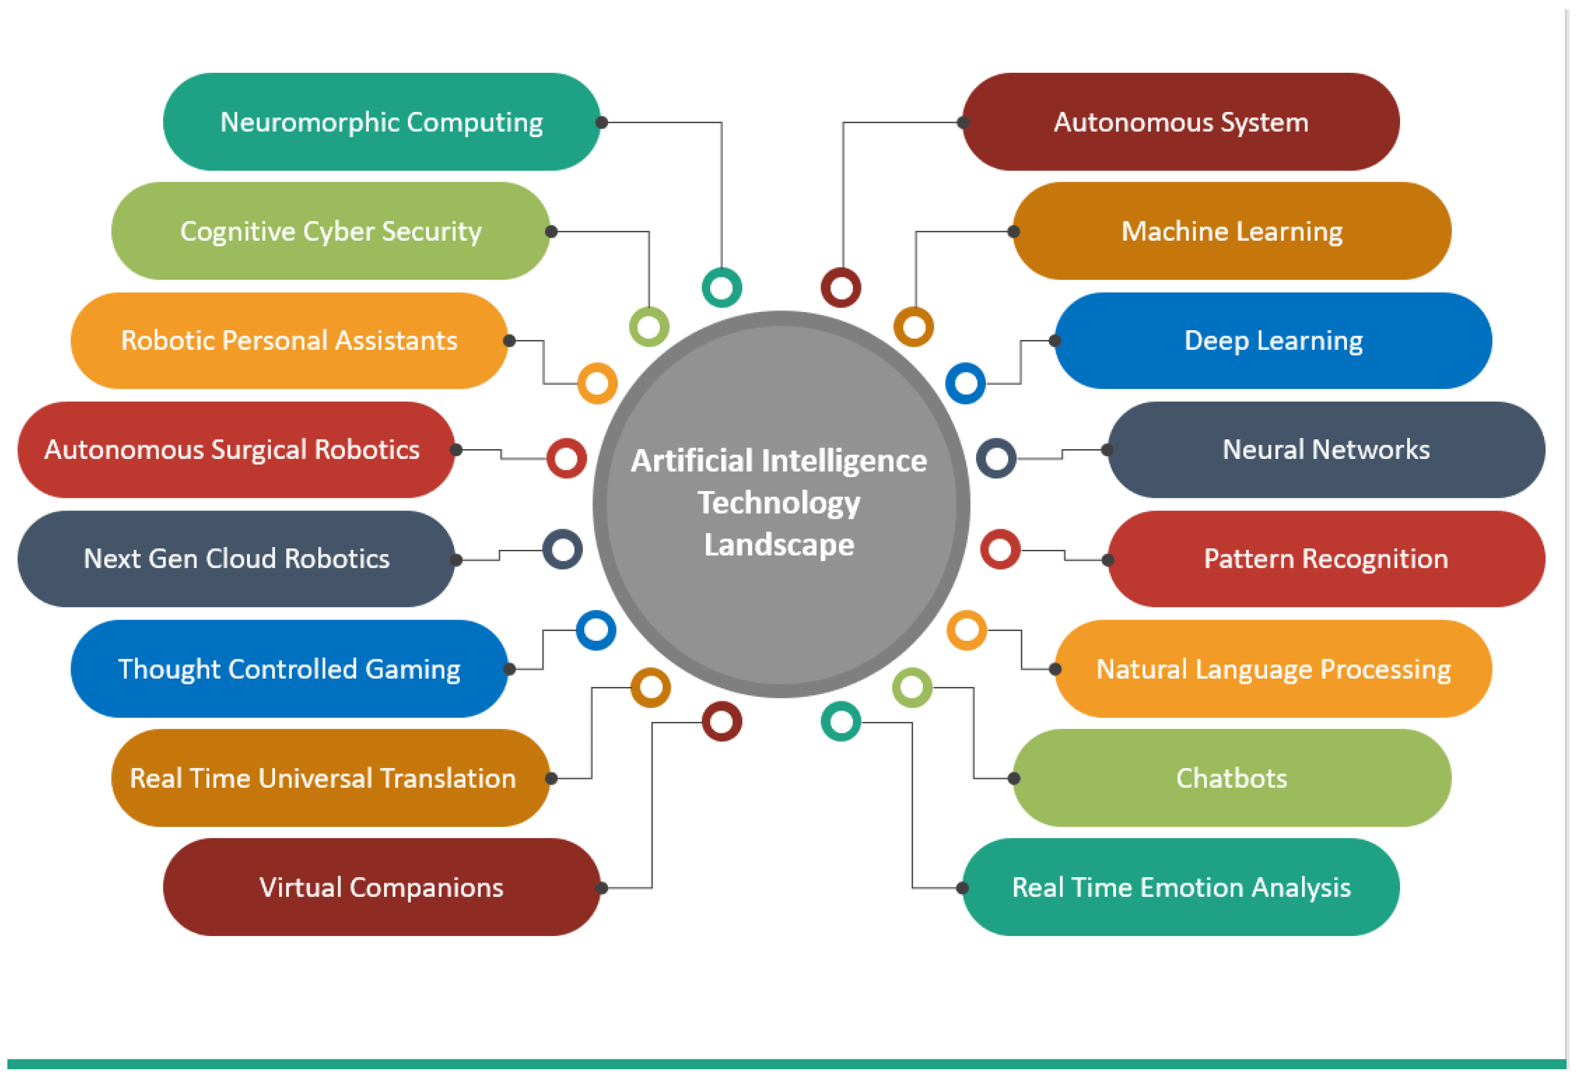

Slide 24
Mintlify – Automated Documentation for Developers
It integrates with your favourite code editor and generates documentation for your code in an instant. Install the Mintlify Writer on your editor, and watch as it generate comprehensive, well-structured documentation for your functions. It is designed to understand your code context and generate relevant descriptions, even interpreting "human-readable" method names. Developers across various programming languages have lauded its efficiency and accuracy.

Slide 25
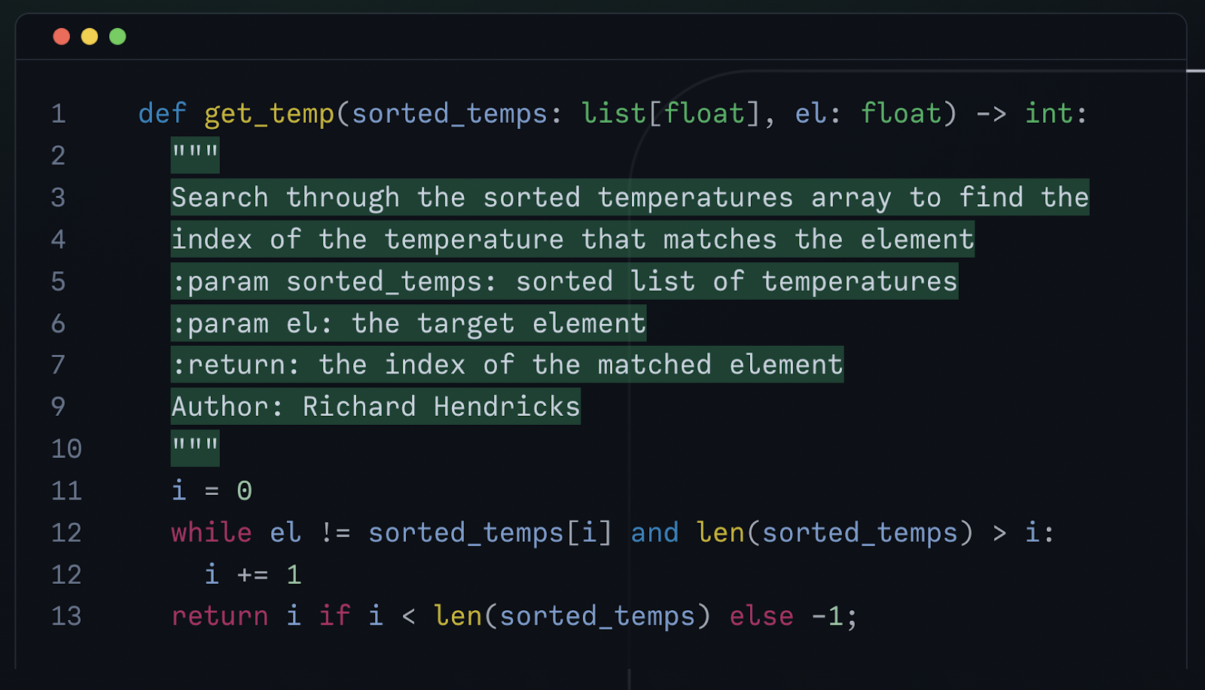
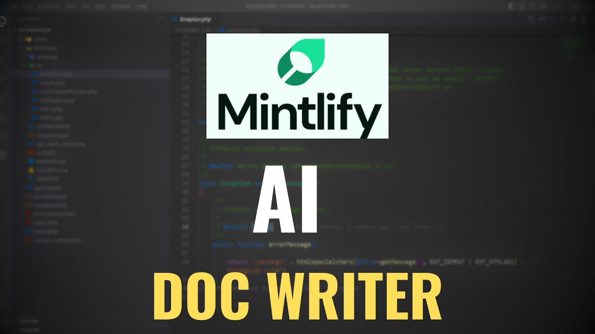

Slide 26
Adrenaline AI – Understand any codebase
It’s a coding AI for developers. This devtool is designed to understand your codebase, acting as an expert consultant available at your beck and call. With Adrenaline AI, you can quickly get insights into how features work or find out where something is implemented. It reduces time wasted in seeking answers externally.

Slide 27
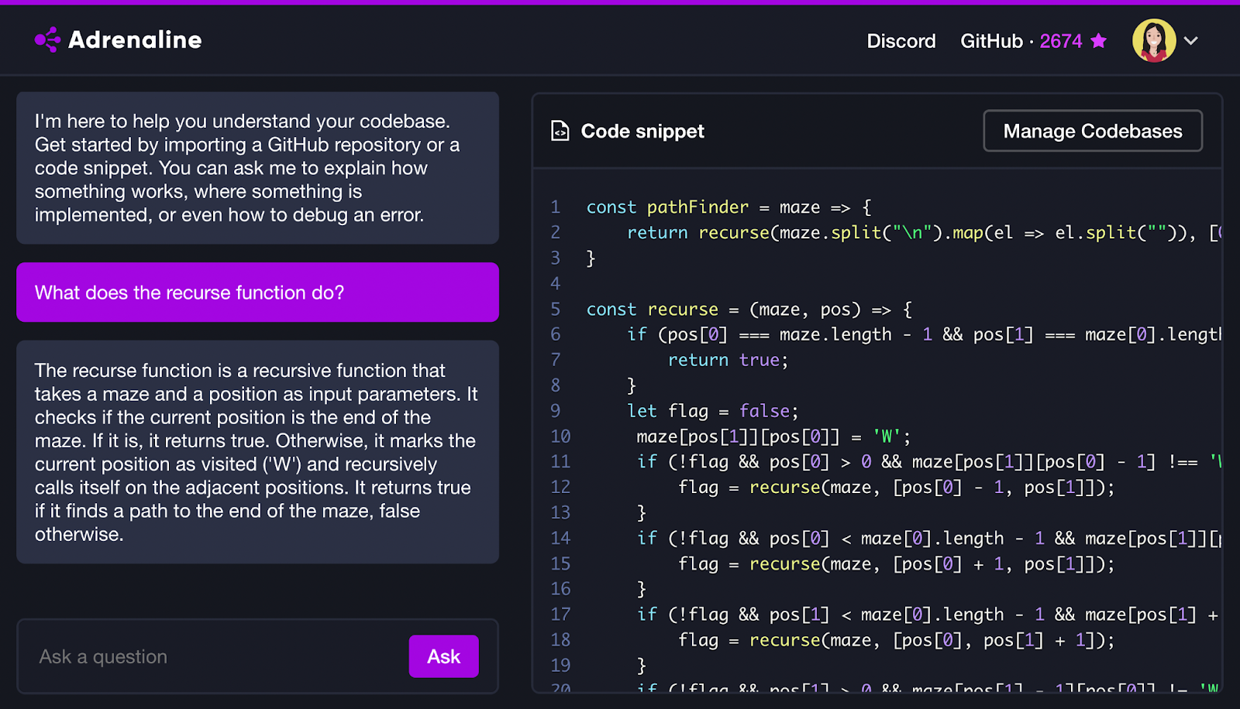

Slide 28
Here are just a few of the implications that AI has on software development:
Increased efficiency in software development
Improved quality control
More accurate predictions for user behavior
Automated coding and application builds
Security and compliance

Slide 29
Automated coding and application builds
AI can also automate many of the tedious tasks associated with software development. For example, AI-driven code refactoring tools can automatically convert existing code into more efficient formats.
Imagine the time savings of automated coding and application builds. That's just one of the many ways that AI can improve software development.
And when it comes to improving the customer experience, AI-driven predictive analytics tools can help developers better anticipate user needs and create more personalized experiences.

Slide 30
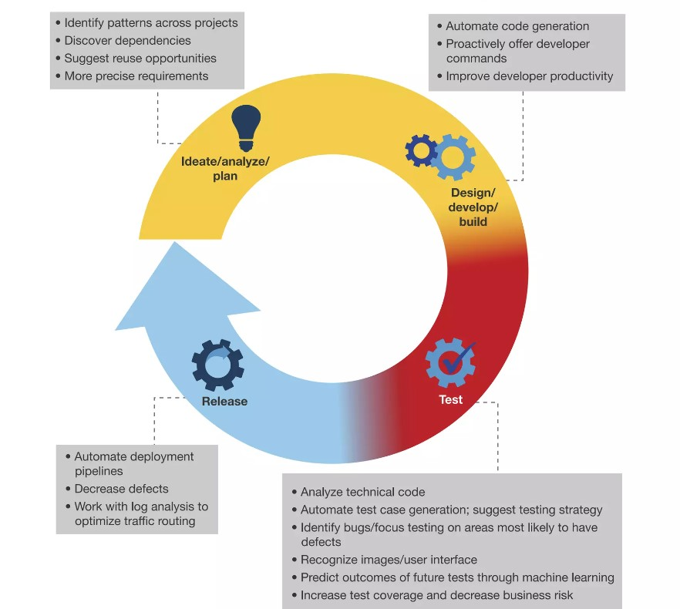

Slide 31
Automated Bug Detection and Resolution:
No software is perfect, and bugs are to be expected.
Fortunately, AI-driven bug detection tools can quickly identify problems in code and suggest actions to resolve them. This reduces the amount of time spent troubleshooting issues and helps developers maintain product quality.

Slide 32
AI-Powered Testing and Quality Assurance:
AI-powered testing frameworks can detect and fix defects automatically, reducing the need for manual intervention. These frameworks can analyze the testing data and identify defects that need to be fixed. They can then apply the necessary fixes automatically, ensuring that the application is functioning correctly.
For example, some tools have the option to automatically update XPaths or other locators for web applications. Popular AI-based software testing tools that use self-healing capabilities include Testim and Healenium.

Slide 33
Difficulty of Debugging
The complexity of debugging is an additional challenge that comes from AI in software testing. Testing software with AI capabilities can provide a lot of data, which can be challenging to understand and comprehend. Additionally, it may be difficult to pinpoint the primary cause of errors and problems due to the complexity of AI algorithms. Software testers may find it challenging to effectively resolve bugs and flaws as a result. Businesses must make an investment in the systems and procedures that will enable them to efficiently examine and interpret the test results produced by AI-powered testing solutions.

Slide 34


Slide 35
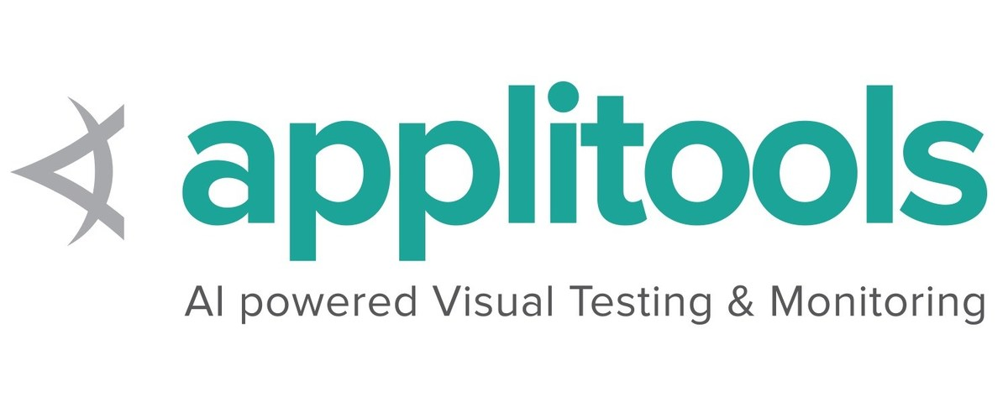
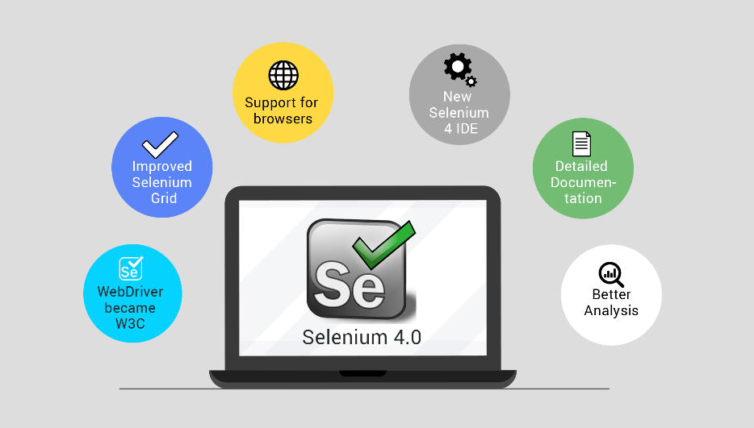

Research AI Tools
Research the available AI tools and choose the ones that are best suited to your needs before integrating AI technology in software testing. There are numerous testing tools powered by AI, and each has advantages and disadvantages. Selenium, Testim, Katalon Studio, and Applitools are some of the most well-known AI-powered testing tools.

Slide 36
Selenium
Selenium is an open-source automated testing tool used for web applications. It provides a framework for writing and executing tests in different programming languages such as Java, C#, Python, etc. Selenium supports various operating systems and web browsers and allows testers to automate web-based tasks like clicking buttons, filling forms, navigating pages, and validating data. It is widely used in the field of software testing for regression testing, functional testing, and cross-browser testing.

Slide 37
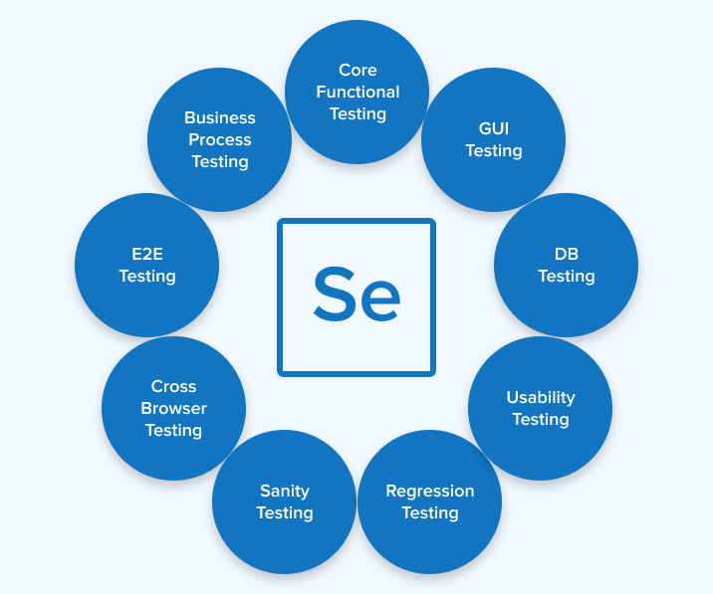

Slide 38
Testim
Testim is an automated testing tool that helps software development teams accelerate the process of testing web applications. It uses machine learning algorithms to create and maintain tests, allowing teams to create reliable and efficient automation tests without the need for extensive coding skills. With Testim, users can easily record, edit, and run tests, as well as analyze test results and reports. It supports popular web technologies and frameworks, such as Angular, React, and Selenium, and can integrate with various development tools and platforms.

Slide 39
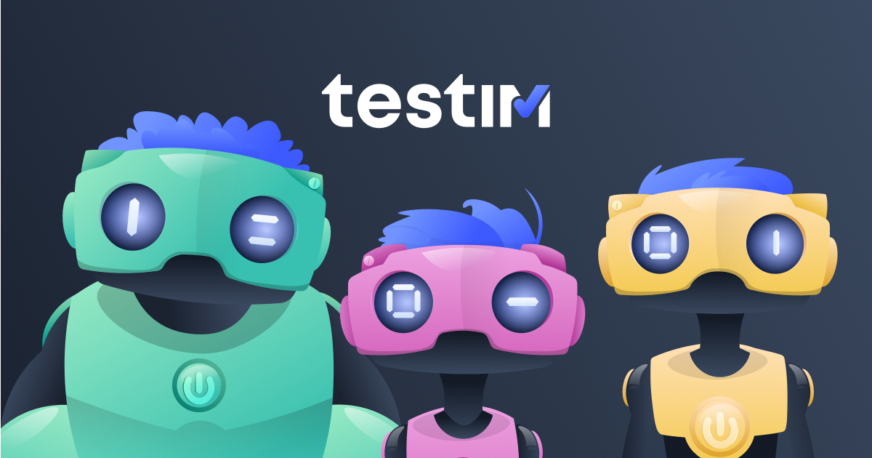

Slide 40
Katalon Studio
Katalon Studio is a test automation tool developed by Katalon LLC. It is an all-in-one solution for web, mobile, API, and desktop testing. Katalon Studio is built on top of the open-source automation frameworks Selenium and Appium, and it provides a comprehensive set of features that aid in test creation, execution, and management.
With Katalon Studio, users can create test cases using a drag-and-drop interface or coding in languages such as Groovy and Java. It supports multiple scripting languages, including Selenium WebDriver, keyword-driven, and data-driven testing approaches. Users can also integrate it with popular CI/CD tools such as Jenkins and Bamboo to facilitate continuous testing.

Slide 41
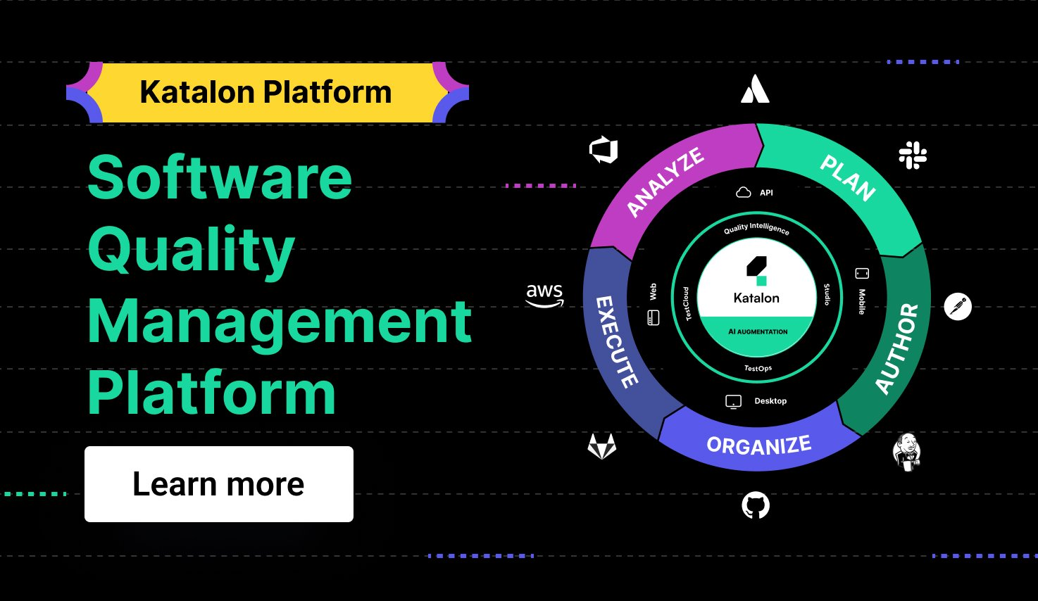

Slide 42
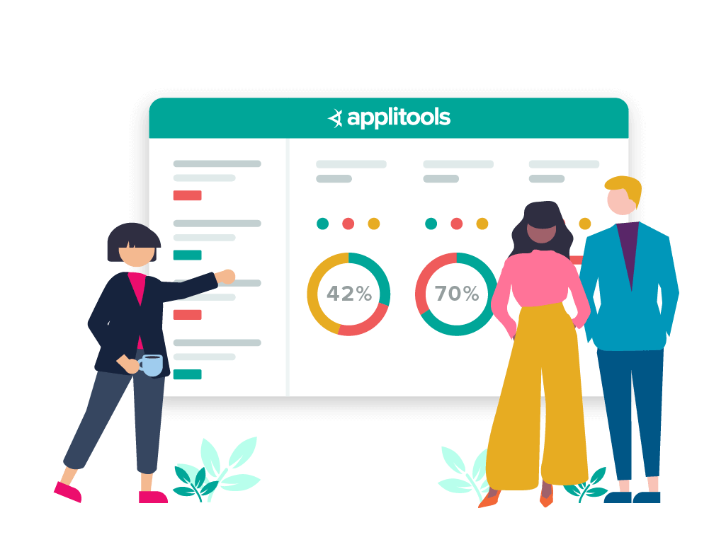
Applitools
Applitools is a software testing and monitoring tool that specializes in visual testing. It uses AI-powered algorithms to compare and analyze visual elements of web and mobile applications across different browsers, devices, and operating systems. Applitools allows developers and QA teams to identify visual bugs, inconsistencies, and layout issues quickly, ensuring that applications look and function correctly. It offers features such as automated visual testing, visual AI analytics, cross-browser and cross-device testing, and integrations with popular testing frameworks.

Slide 44
Improved user interface (UI) design and testing
Nothing beats a seamless user experience. AI can help software developers create stunning UIs by using natural language processing (NLP) to generate UI designs based on customer needs.
This helps developers quickly create interfaces that are tailored to a specific user group, making the experience more intuitive and enjoyable.
AI development within UI and UX can also help automate the testing process by running simulations of user interactions on different platforms. This helps developers gain insights into how users interact with the software, enabling them to quickly diagnose errors and make necessary changes.
By leveraging AI-driven UI and UX development, businesses can create better user experiences for their customers that are tailored to their needs - and build upon learning data that can be used to improve their products in the future.

Slide 45


Slide 46
AI-Driven Software Project Management:
One of the key areas where AI can enhance project planning is in predicting project timelines and milestones. By analyzing historical data from previous projects, AI algorithms can identify patterns and predict potential bottlenecks or delays. This information can help project managers set realistic deadlines, allocate appropriate resources, and devise contingency plans to mitigate risks.

Slide 47
AI-Driven Software Project Management:
AI can improve resource allocation in software development projects. With the ability to analyze project requirements and match them with the skills and availability of team members, AI systems can suggest the most suitable individuals for specific tasks. By optimizing resource allocation, project managers can ensure that projects are completed efficiently while considering individual strengths and workload balance.

Slide 48
AI-Driven Software Project Management:
Risk management is another critical aspect of software project management. AI can assist in identifying potential risks by analyzing data from various sources, including project documentation, task completion rates, and team performance. By flagging potential risks in real-time, AI-driven systems can provide project managers with the information needed to make proactive decisions, such as adjusting project plans, reallocating resources, or implementing preventive measures.

Slide 49
How AI is Improving Communication and Collaboration in Project Management
Efficient communication and collaboration are the pillars of successful project management. AI is playing a pivotal role in revolutionizing how project stakeholders interact and work together.

Slide 50
AI enhances communication by:
Natural Language Processing (NLP): AI-powered chatbots and virtual assistants facilitate seamless communication through conversational interfaces.
Language Translation: AI can translate communication into various languages, enabling global teams to collaborate effortlessly.
Sentiment Analysis: AI tools analyze sentiment in communications, helping project managers gauge team dynamics and identify potential conflicts.

Slide 51
AI-Enabled Predictive Analytics:
In the ever-evolving realm of software development, AI algorithms have emerged as powerful tools to enhance productivity and streamline processes. One of the most impactful applications of AI in this domain is predictive analytics. By leveraging historical data and utilizing advanced algorithms, AI-enabled predictive analytics offer significant advantages in predicting software defects, code quality, and project timelines.

Slide 52
AI-Enabled Predictive Analytics:
Here’s How AI-enabled Analytics Services are Impacting Several Industries :
Predictive Analytics Solutions: AI algorithms can analyze data and identify patterns that are not easily visible to humans. This enables telecom companies to predict customer behavior and make proactive decisions based on that data.
Network Optimization: AI algorithms can analyze network performance data and identify areas for improvement. This can help telecom companies optimize their network performance, ensuring that customers receive high-quality service and experience minimal downtime.
Automated Data Collection: AI can automatically collect and process vast amounts of data from several sources, reducing the manual effort required for data collection. This enables telecom companies to have access to more accurate data, making it easier for them to make informed decisions through big data engineering services.
Customer Segmentation: AI can help telecom companies to segment their customer base based on various criteria such as demographics, usage patterns, and purchase history. This allows for targeted marketing campaigns, which can result in increased customer engagement and sales.
Fraud Detection: AI can detect and prevent fraudulent activities, such as unauthorized access to sensitive information and billing fraud. This helps to protect telecom companies and their customers, reducing the risk of financial losses.

Slide 53
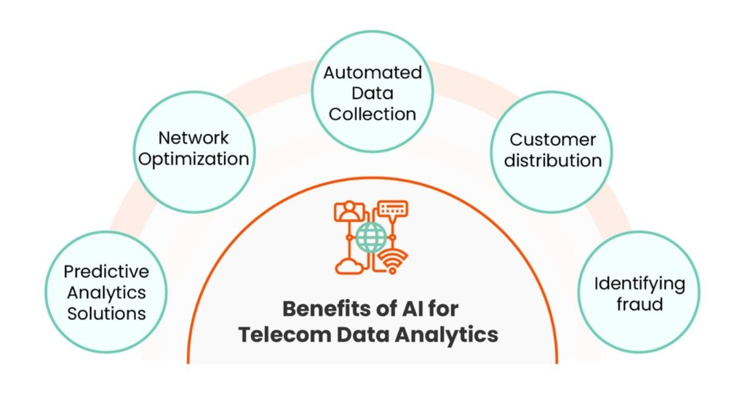
AI-Enabled Predictive Analytics:

Slide 54
AI-Enabled Predictive Analytics:
Effect of AI on Telecom Data Analytics :
Customer segmentation: AI can play a major role in segmenting customers based on their behavior and demographics. This helps retailers in targeting their marketing efforts to specific customer groups facilitating improved conversion rates.
AI Personalization: Leveraging artificial intelligence to personalize the shopping experiences for customers is a predominant move among leading retailers today. AI helps recommend products based on the customers’ browsing and purchase histories.
Predictive analytics: Retailers are leveraging AI to analyze customer data and predict future sales, trends, and demand. This allows better inventory management, cost optimization, and enhanced customer experience.
Inventory management: AI algorithms are being utilized to predict demand for products and thereby implement optimization of inventory levels. This is assisting retailers in evading stock outages and overstocking.
Fraud detection: AI can be leveraged to detect fraudulent behavior in transactions, such as detecting patterns of suspicious activity.

Slide 55
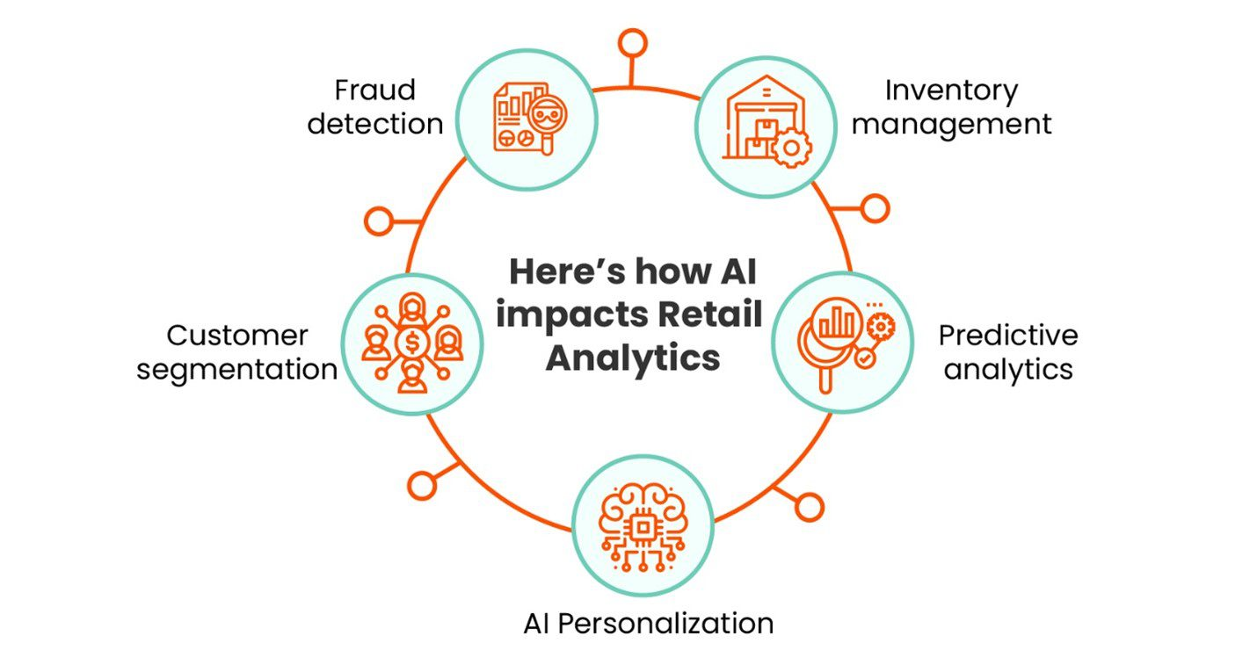
AI-Enabled Predictive Analytics:

Slide 56
Ethical Considerations in AI-Augmented Software Development:
Transparency. AI systems should be transparently designed and deployed, clearly explaining their capabilities and limitations and ensuring accountability and trust.
Fairness and equity. Developers should strive to eliminate bias and ensure equitable access to AI technologies, preventing discrimination and promoting equal opportunities for all individuals.
Privacy and security. AI systems should handle data securely and ensure user consent, minimizing risks of unauthorized access and misuse.
Accountability. Developers should be accountable for the behavior and impact of their AI systems, taking responsibility for any harm caused and implementing mechanisms for recourse and redress.

Slide 57
Ethical Considerations in AI-Augmented Software Development:
Human-centered design. AI technologies should prioritize human well-being, augment human capabilities, and respect human autonomy, avoiding undue concentration of power and prioritizing user needs.
Robustness and reliability. AI systems should be built to be robust, resilient, and reliable, undergoing rigorous testing and validation to mitigate risks of errors, biases, or unintended consequences.
Social impact. Developers should consider the broader social implications of AI deployment, actively working to address societal challenges and minimizing adverse effects on employment, inequality, and other areas.

Slide 58
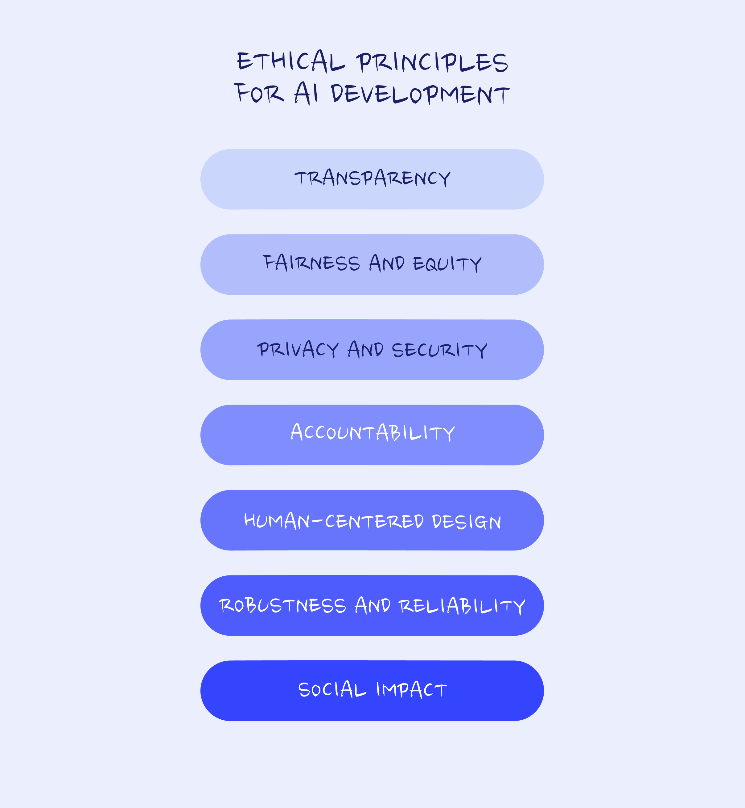

Slide 59
Future of AI-Augmented Software Development:
One of the main areas where AI is impacting software development is in the automation of repetitive and mundane tasks. AI-powered tools can now analyze and understand code faster than ever before, leading to a significant reduction in the time and effort required for tasks like debugging, code refactoring, and optimization. By automating these routine activities, developers can focus more on creative problem-solving and innovation, ultimately leading to faster development cycles and better software quality.

Slide 60


Slide 61
Future of AI-Augmented Software Development:
Another exciting prospect of AI-augmented software development is the assistance provided during the design phase. AI algorithms can now generate code snippets based on high-level descriptions and specifications, saving developers time by providing a starting point for various tasks. Additionally, AI can assist in the detection of potential bugs or vulnerabilities early in the development process, minimizing the risk of security breaches.

Slide 62
Future of AI-Augmented Software Development:
Looking further into the future, AI-augmented software development could potentially lead to the emergence of intelligent programming assistants. These virtual assistants would be capable of understanding natural language queries and providing real-time guidance and suggestions, aiding developers in solving complex problems efficiently. They could offer insights on performance optimizations, recommend design patterns, and help in the integration of third-party libraries or APIs. This level of assistance could be crucial for both experienced developers looking for guidance and novices trying to learn programming.

